Slide 1

Society for peace and capacity building
NGO profile

Slide 2
About us
We are Non-Governmental Body for the purpose of dedicating ourselves collectively and sincerely towards the promotion and development of Nigerian citizens both at home and in diaspora by advocating, engendering and enhancing our socio-economic growth, unity and peace initiative, capacity building, cultural rejuvenation, improvement of our social well-being and advocating for policy changes and raise awareness about issues affecting Nigerian society.

Slide 3
What we do
We also create a critical thinking space and address the National Platform’s critical needs for dialogue and understanding that foster positive change.
This focus on peace advocacy, capacity building, and empowerment with youth leadership fostering integration and promoting peaceful coexistence across the nation.
Also, promote unity and peace by fostering dialogue, understanding, and reconciliation among diverse communities. We intend to empower citizens by providing resources, training, and support and actively participate in civic engagement governance and community development

Slide 4
What we do
Our collaboration with the National Assembly on peace and capacity building typically involves working together to strengthen the legislative framework for peace initiatives and improve the capacity of individuals, institutions, and communities to promote peace and security. Such a partnership is critical for creating long-term, sustainable peace in a country. Here are some key areas where collaboration between peacebuilding organizations and national legislative bodies like the National Assembly could occur:

Slide 5
What we do
Strategic Partnerships for Peace and Capacity Building. We aim to collaborate with international and national key ministries, and agencies for developmental activities in Nigeria.:
To organize Conferences, seminars, workshops, symposia, and other events to provide training and promote interaction and understanding among Nigerian citizens. We, members of the Society for Peace and Capacity Development (SPCB), are a group of concerned citizens and professionals representing Nigeria and beyond. Our mission is to provide a platform for systemic advocacy to strengthen peace structures and advance the well-being of the people and the nation.

Slide 6
What we have done
We have enhanced productivity through a sensitization program, offering skill development training on workshop collaboration. Mentorship and resources to enhance productivity. Entrepreneurship and economic opportunities available to the Nigerian.
We have engaged in various leadership programs and nurtured and supported emerging leaders who demonstrate commitment to peace, productivity, and social change.
We have cohesion by organizing community-building activities, and cultural events, that will celebrate diversity and strengthen social harmony within our society as one Nigeria.

Slide 7
What we have done
We are the Sandals on the ground. We have been doing person-to-person sensitizations. Through our talent hunt we identify some young people who doing some innovation and invention require equipment support. We have identified prospective partnerships with ideal ministries. As well, as initiated communication with the National Assembly. While also in talks with the National Youth Service Corps (NYSC) over a proposed sensitization exercise. We also engage with the Federal Ministry of Special Duties And Inter-Governmental Affairs in certain areas of collaboration.

Slide 8
What we have done
A recent hybrid meeting highlighted the extraordinary efforts of two Nigerian citizens who filling critical gaps in their communities. One without formal employment, dedicated (6am 6pm) to traffic control a hazardous intersection in Kubwa at Bwari Area council, a task often left unattended. The other a PTA teacher in Jabi 1, Primary School, AMAC, FCT, teaches 28 teaches highlighting the strain on the educational system. These individuals' selfless service underscores the need for greeter support and resources within these communities

Slide 9
What we have done
A recent hybrid meeting highlighted two Nigerian citizens’ extraordinary efforts to fill critical gaps in their communities. Without formal employment, one dedicates himself (6 am-6 pm) to controlling traffic at a hazardous intersection in Kubwa, Bwari Area Council, a task often left unattended. The other, a PTA teacher at Jabi 1 Primary School, AMAC, FCT, teaches 28 students, highlighting the strain on the educational system. These individuals' selfless service underscores the need for greater support and resources within these communities.

Slide 10
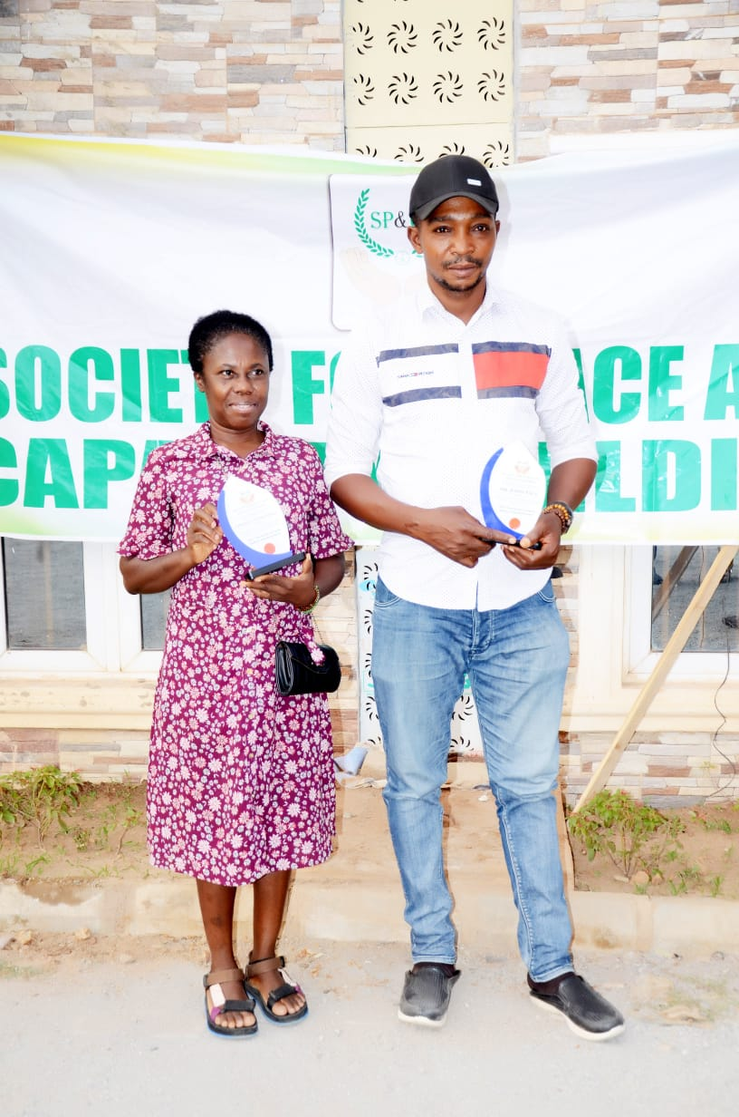
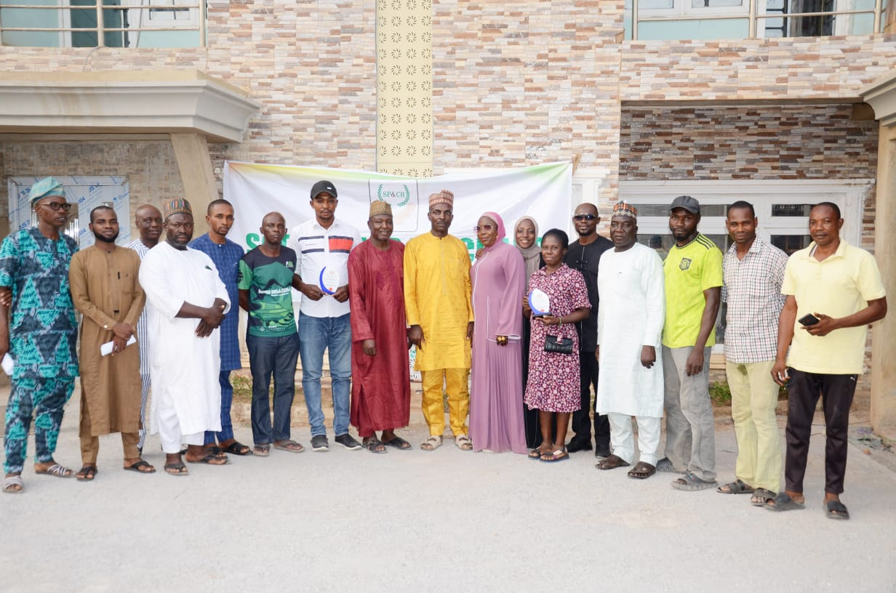
HYBRID MEETING, SENSITIZATION AND AWARDS CEREMONY

Slide 11
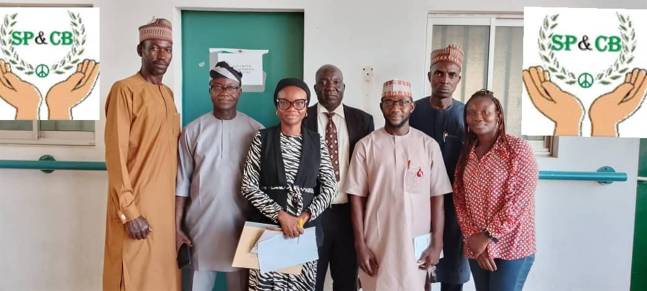
REPRESENTATIVES from the Society for peace and Capacity Building and representatives from the Federal Ministry of Special Duties and Intergovernmental Affairs

Slide 12
What we INTEND TO do
Increased political will to address the structural causes of conflict.
More effective capacity building programs driven by informed, inclusive, and accountable policymaking.
Engagement of key stakeholders, including marginalized groups, in peace processes and capacity building.
Sustainability of peace efforts, through continuous oversight and adaptation.

Slide 13
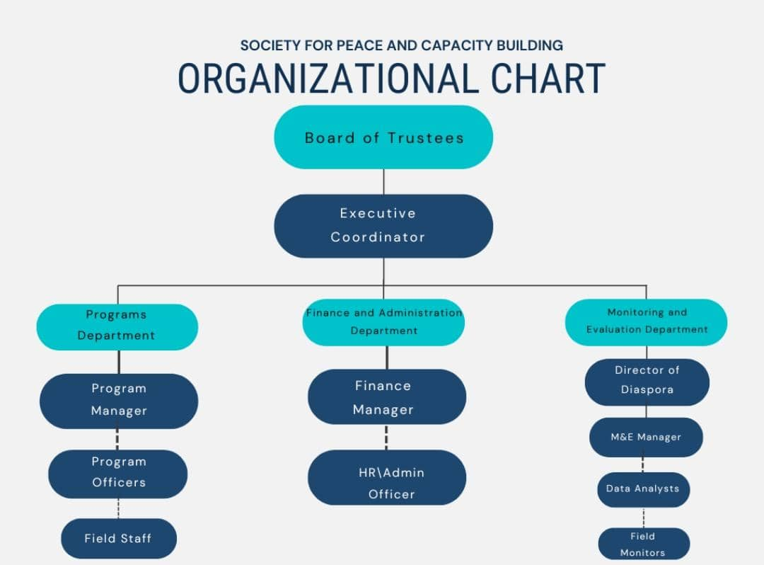

Slide 14
Management team organogram
Executive Coordinator – Abdullahi Musa
Director Programs - Dr. Kenneth S S Enebe
Director of Finance and Administration – Muhammad Jabbo
Director Monitoring and Evaluation – Ibrahim Kolo
Director Diaspora – Ahmed Omeiza
Welfare – Kazeem Jibrin
Legal – Mrs Mercy Kazi
Media – Mohammed Garba
Program Manager – Mrs Haulat Ibrahim

Slide 15
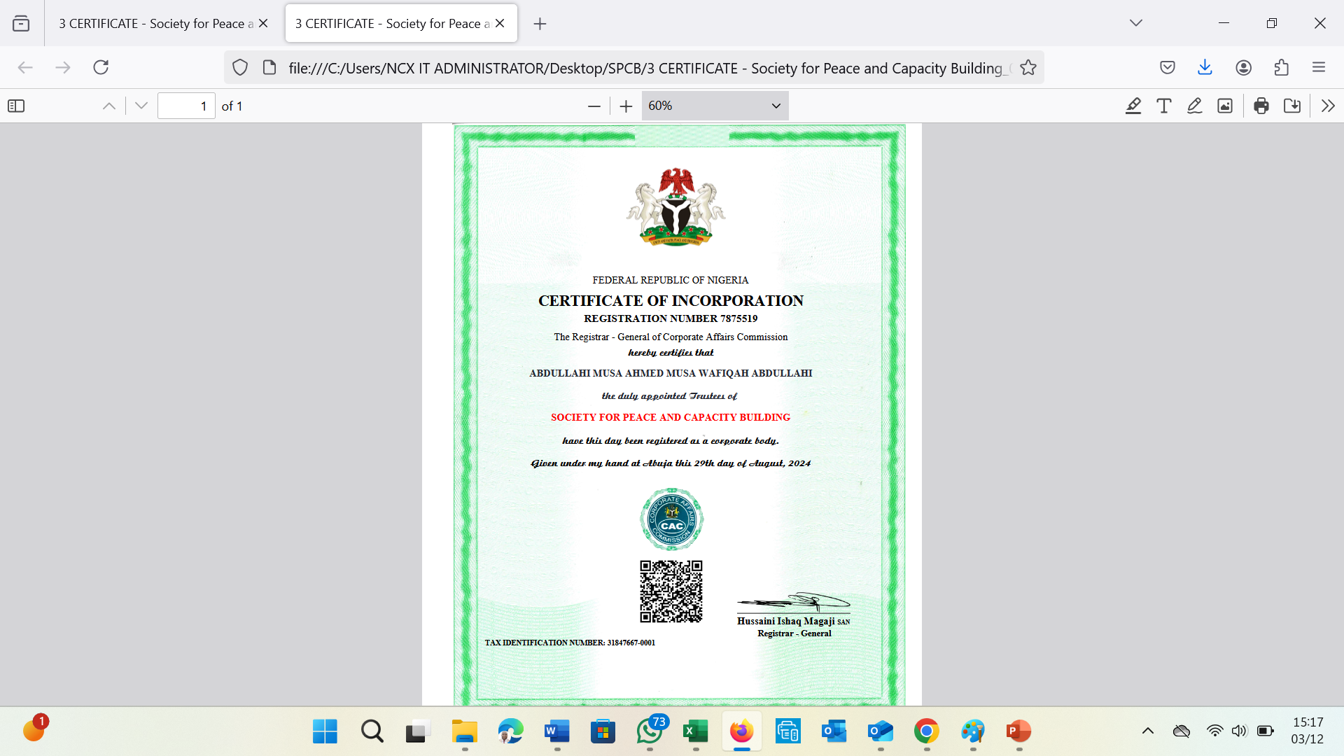
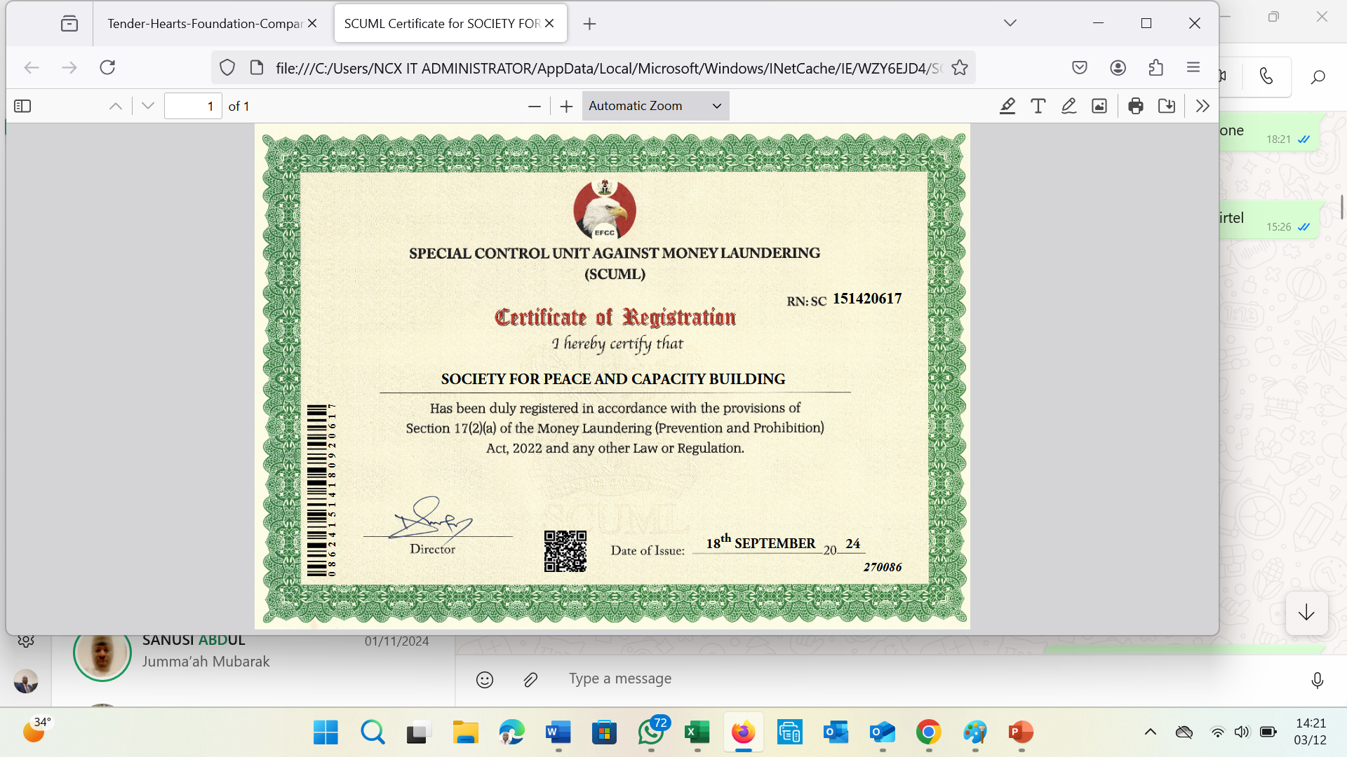

Slide 16
Contact us
Email Address : spcb.org@gmail.com
Phone Numbers: 08062843475, 07017707610
WhatsApp: 07017707610
Website: www.spcb.org.ng

